Slide 1
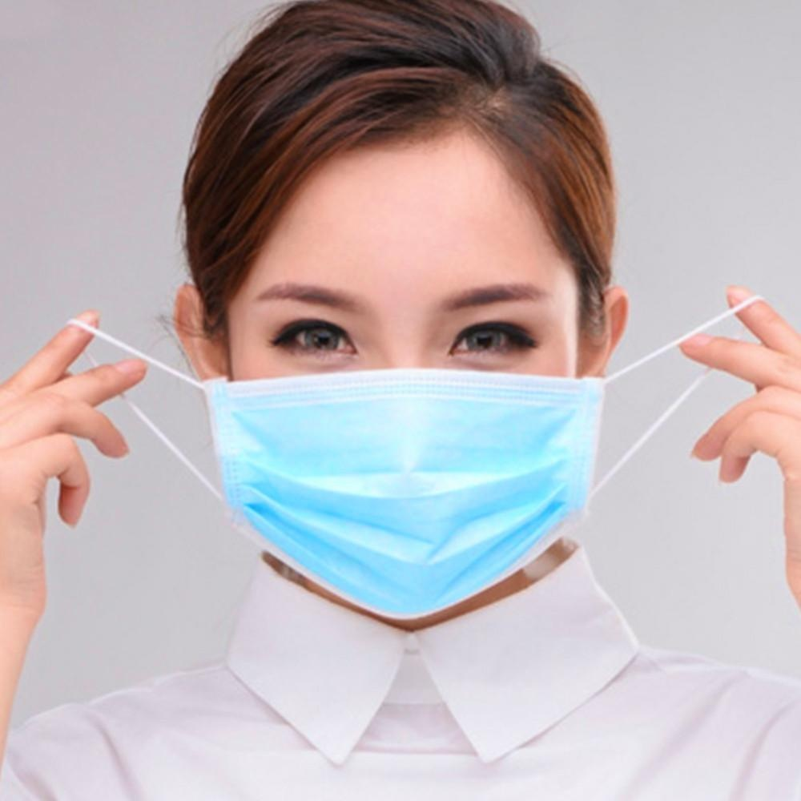
Face Mask Detector
Evan Yeoh, Looi Yih Foo

Slide 2
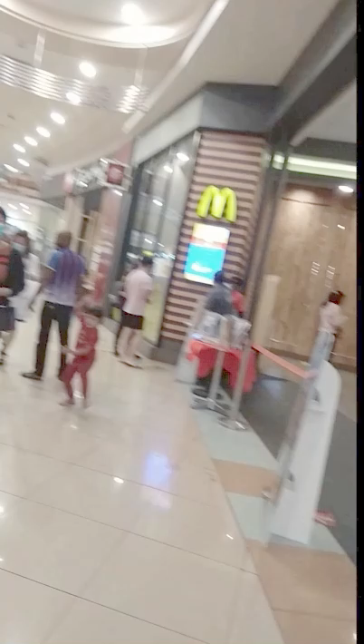
Notes:
1 min mark: Guy stops at bakery

Slide 3
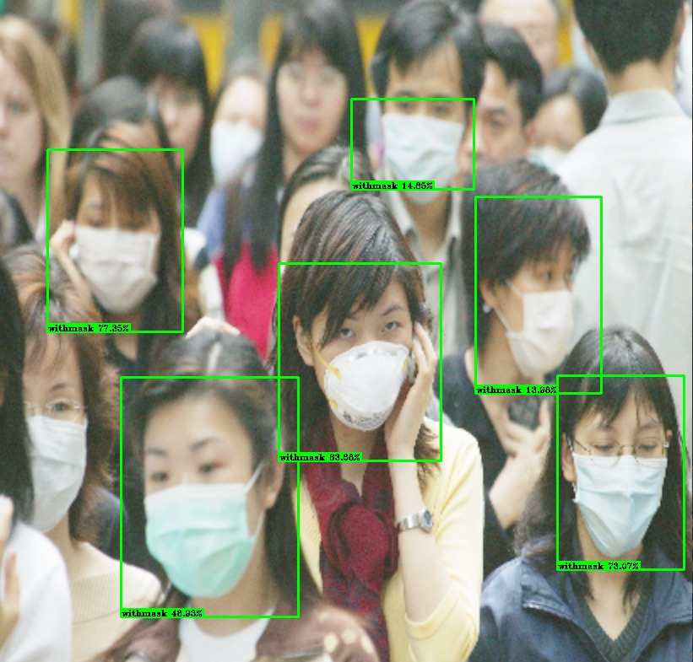
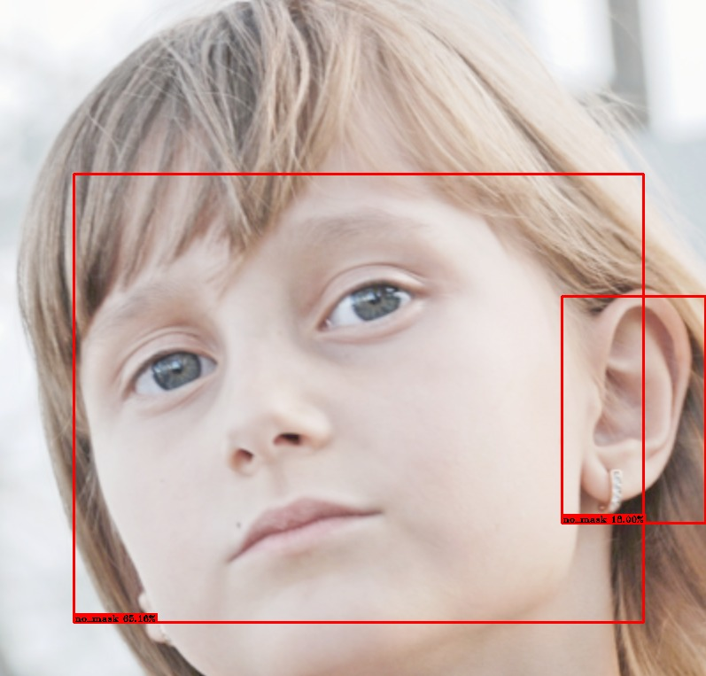
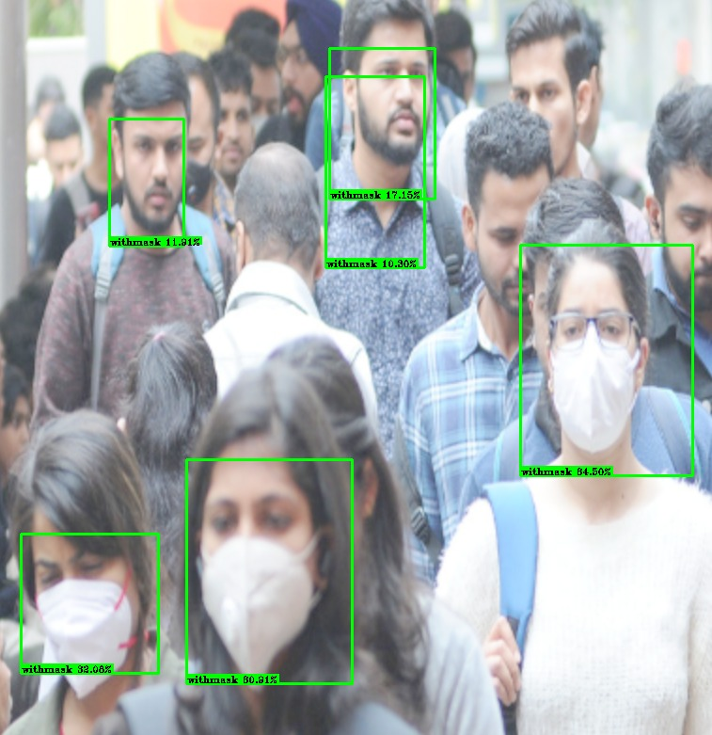
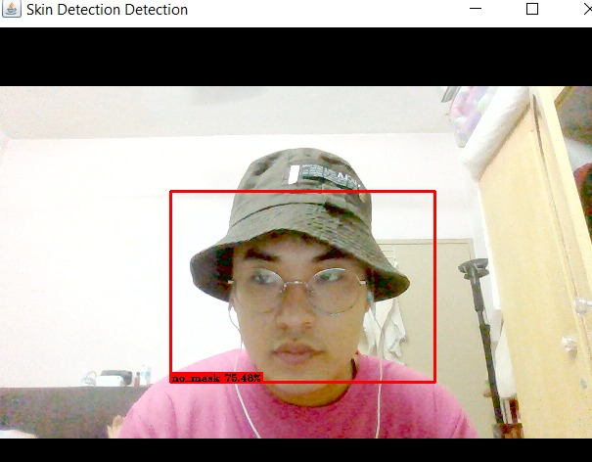
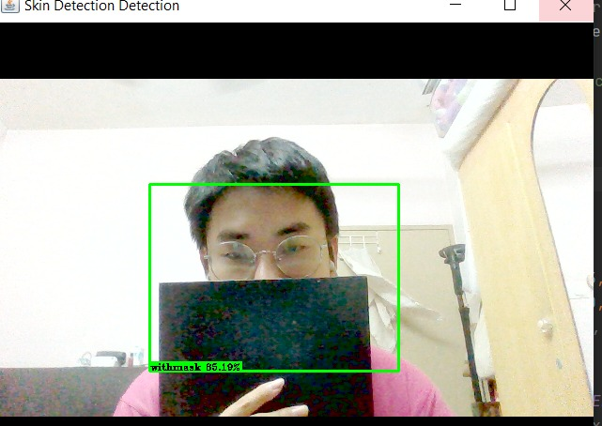
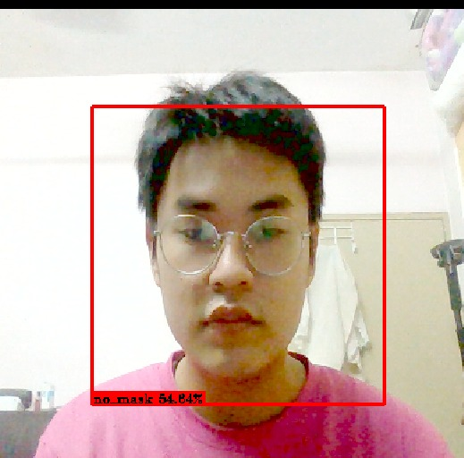
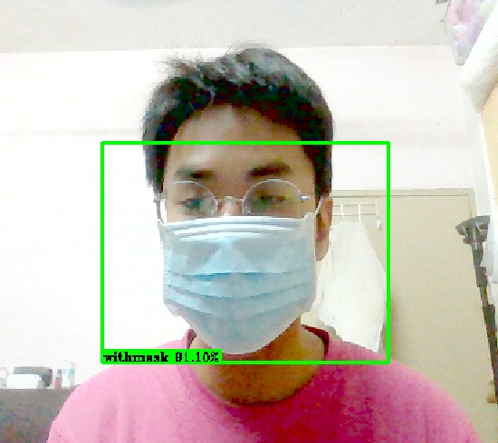

Slide 4
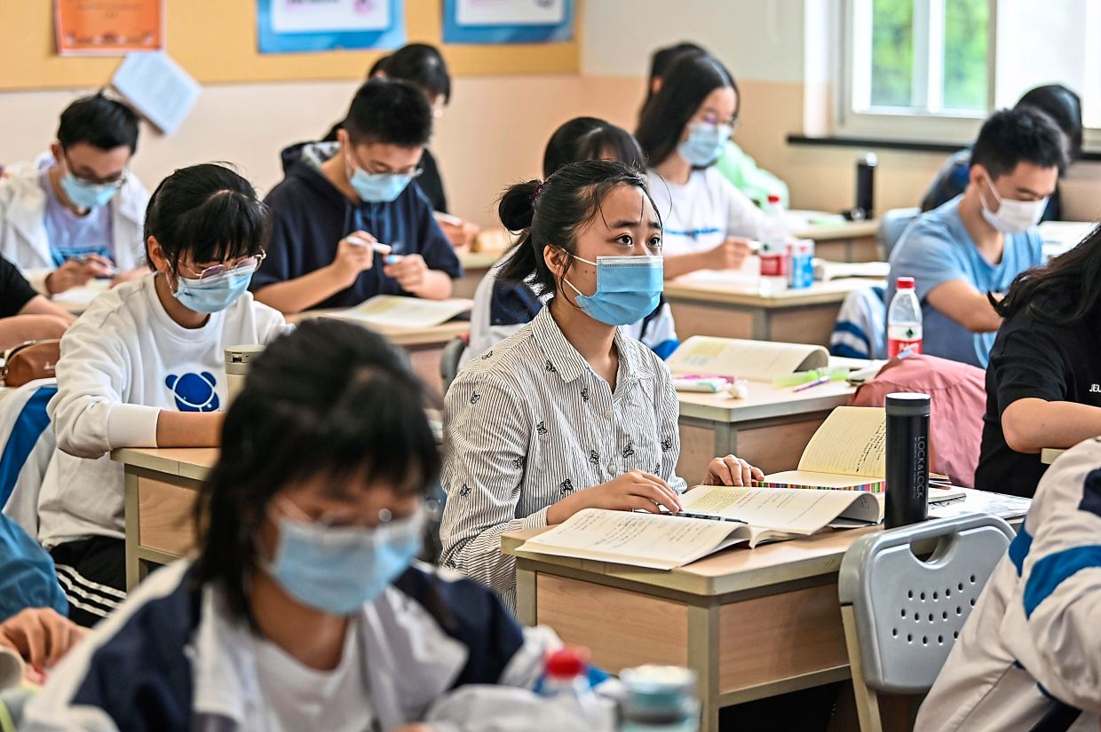
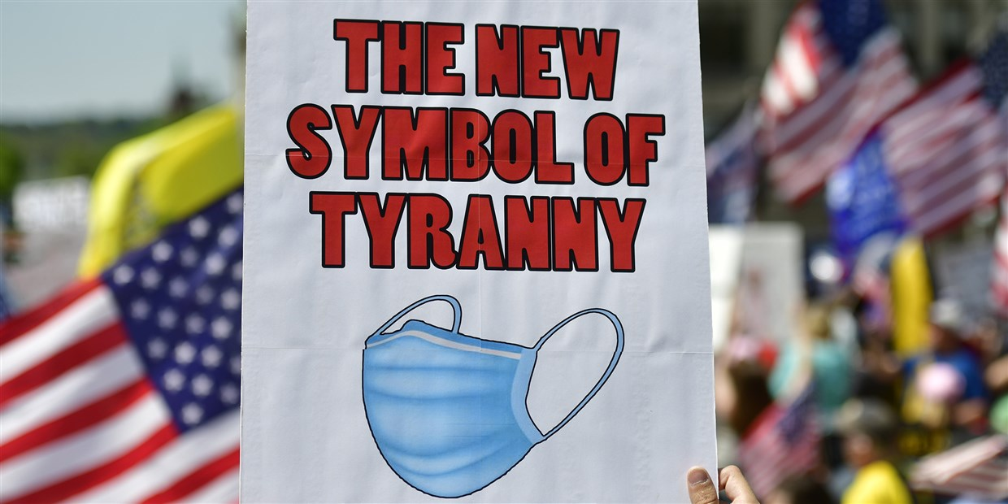
Introduction
Spread of Covid-19 made covering nose and mouth a requirement in many public areas
Compliance is not always easy to enforce
Notes:
Covid-19 is highly infections: Sneeze, cough transmits
Covering reduces risk of transmission significantly (by >50%)
Our idea: Aid enforcement with technology to measure if people follow or not

Slide 5
Issues faced with identification

Slide 6
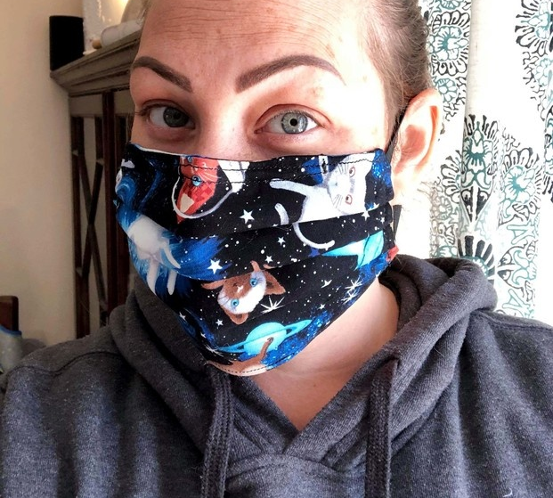
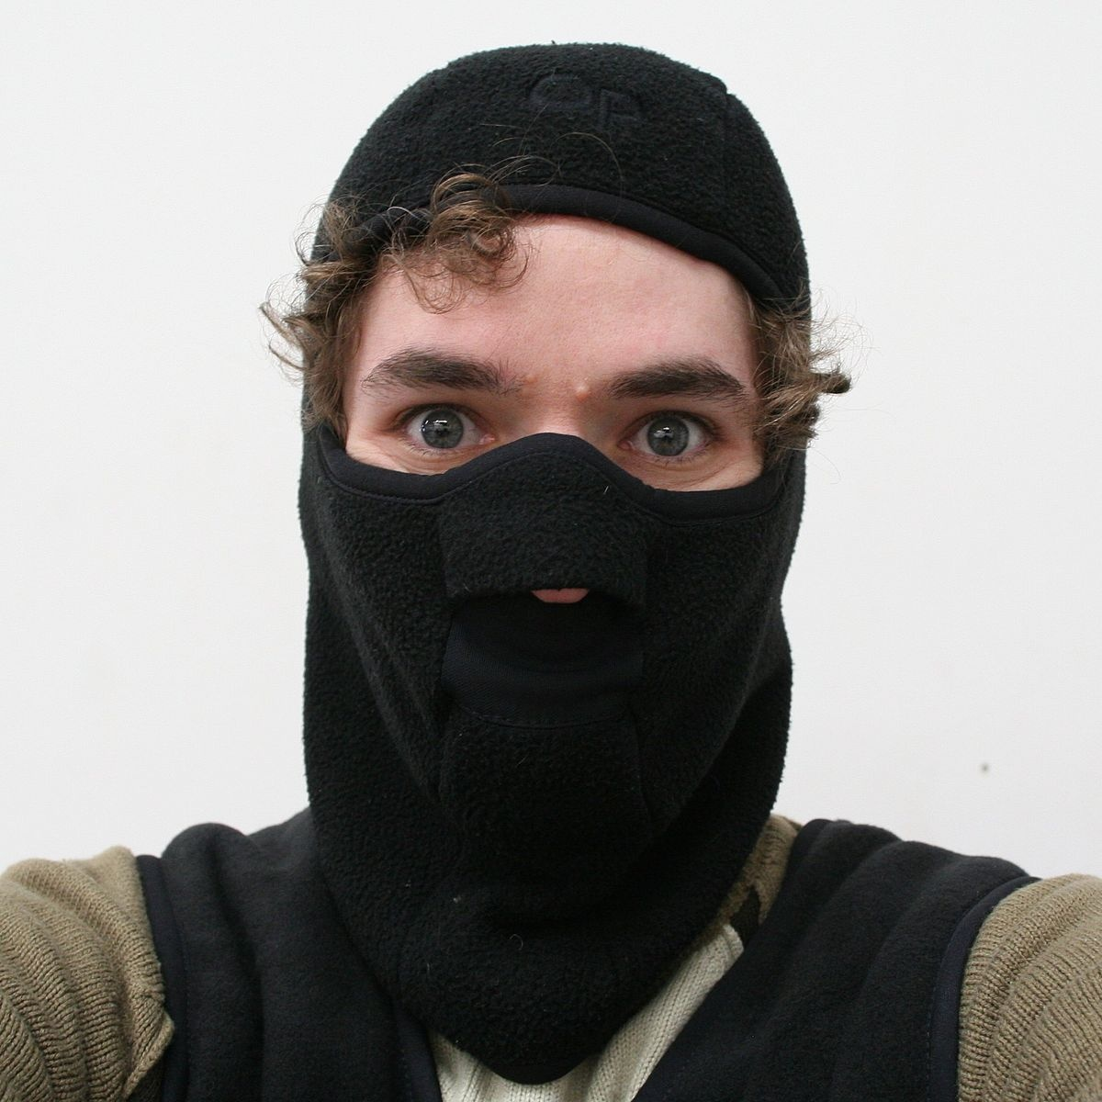
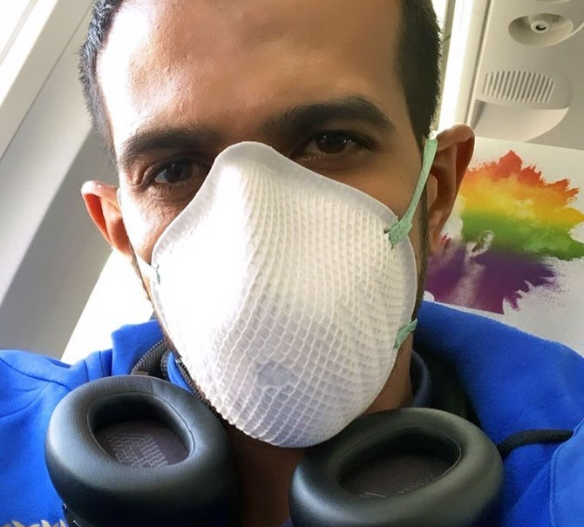
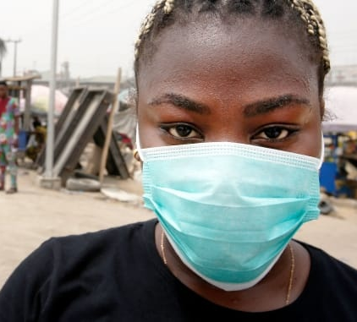
1. Large variety in mask designs
What’s a mask?
Notes:
Typical problem: Mark is lightly coloured, blends with skin (dark = dark skin , light = light skin)
For us: Object that obscures nose+mouth, but leaves eyes visible

Slide 7
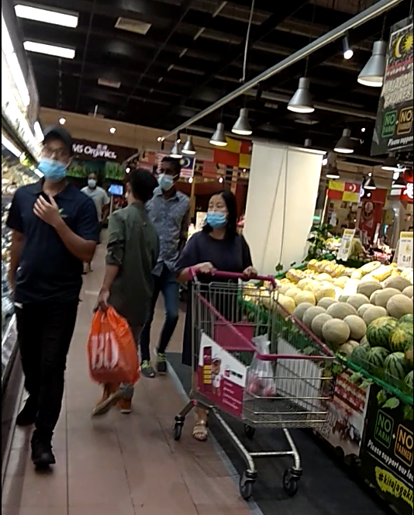
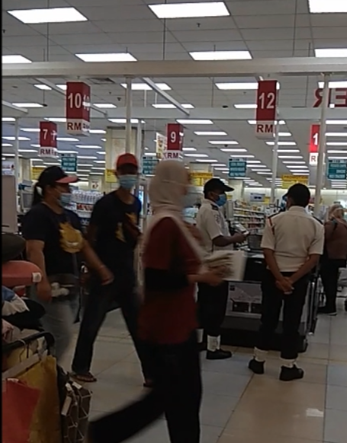
2. Background noise Clean, passport-photo backgrounds are impossible in real life
Notes:
Typical noise: Lights, background objects, person itself (accessories, outfits)

Slide 8
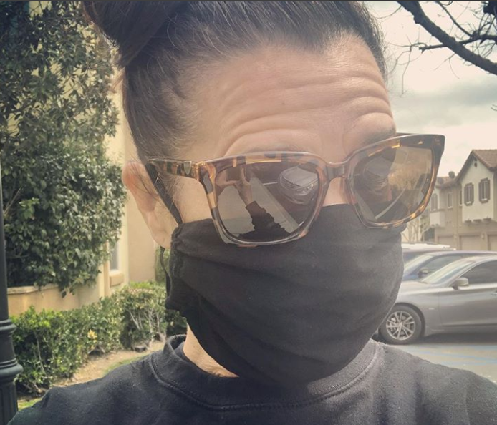
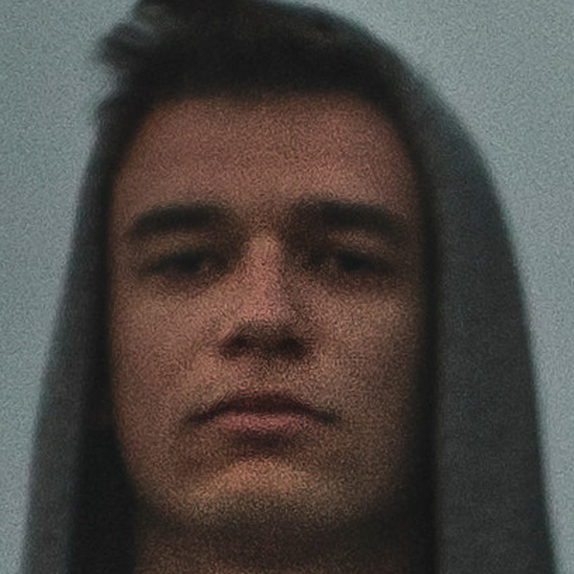
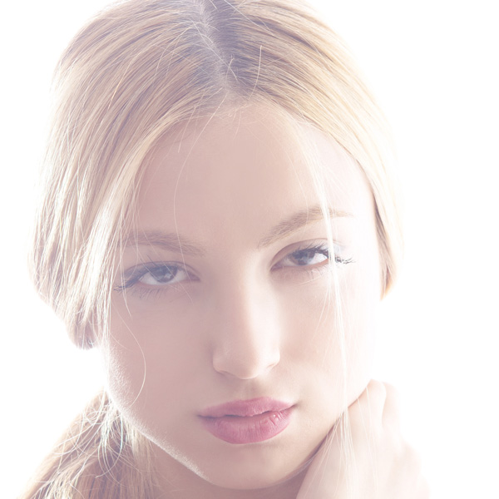
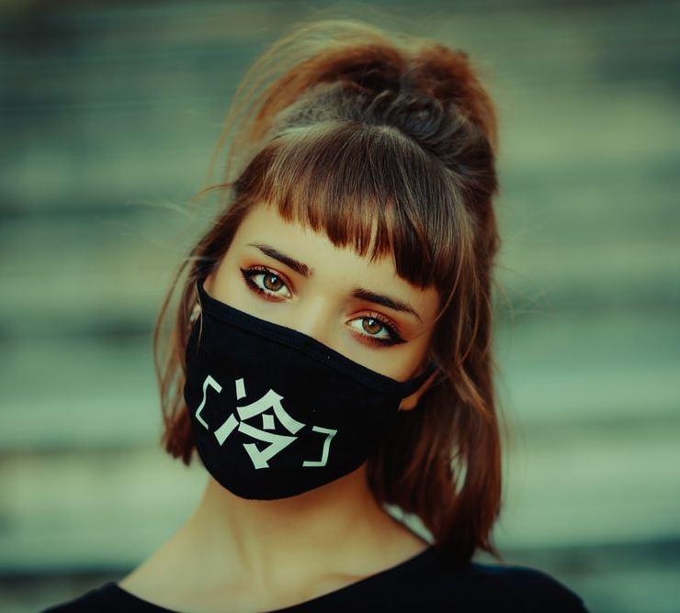
3. Varying image quality
From camera used, image conditions
Notes:
Model relies on finding pixels that resemble target feature
Anything that obscures features will mess with identification
Ex: Training on lighter coloured masks, training in brightly-lit and high res images

Slide 9
The idea
Gather images of people wearing and not wearing face masks, with as much variety as possible
Train YOLOv2 model to detect differences in person’s appearance, in many possible background and image conditions
Test model’s performance against a set of test data and in real life video image
Notes:
Variety: Account for many different appearances
Test: To check performance, fine-tune

Slide 10
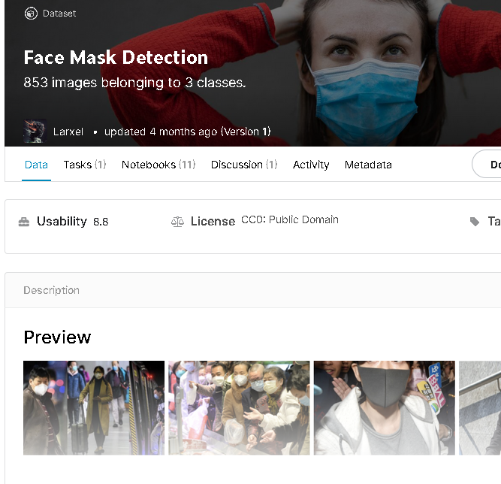
The journey – Data collection
Bulk of data from past Kaggle challenges
Dataset is balanced between masked and unmasked faces
Overwhelming majority as JPG. Only 9% PNG
Source: https://www.kaggle.com/andrewmvd/face-mask-detection/metadata
Notes:
Bulk of data from past Kaggle challenges
- Prior competitions held (by ISIC) provides ready-made databases. But data highly skewed towards moles: >60%
Dataset is skewed towards nevus-es (moles). Needed to scrape additional data from Google Images
Solution? Undersample nevus, oversample melanomas and old age moles
Made up for missing data for melanomas and old-age moles using Google Images
- By the end, had 600 images for each of these output classes

Slide 11
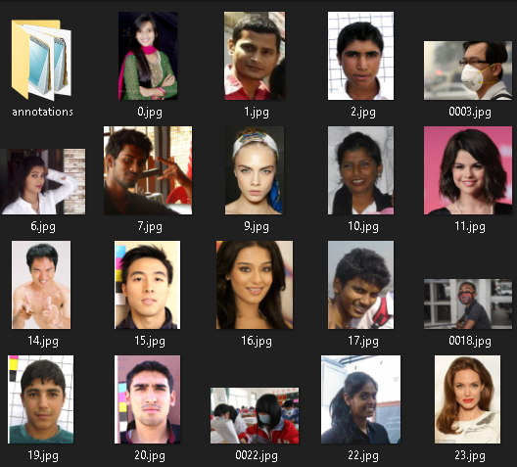
The journey – Annotation
Data annotated using labelImg (https://github.com/tzutalin/labelImg)
Labels stored as PascalVOC .xml

Slide 12
The journey: Data processing
Images came in various sizes Solved by resizing with Windows 10 Image Resizer
Provided labels tended to focus on entire face Redrew labels to tightly fit region of interest (eyes, nose, mouth)
Notes:
Sizes: Need to be uniform in at least 1-dimension for model to train
Labelling: Any unnecessary features makes model sensitive to noise later
Labelling process = Drawing box tightly around feature of interest

Slide 13
The journey: Architecture and modelling
Model: YoloV2
Modifications: Set output conv2d_23 layer as convolutional to accept inputs of varying sizes Adjusted shape of YOLO model output layer conv2d_23 for 2 output classes Adjusted epochs & sample batch size to reduce loss score Maximised threshold to remove low-confidence predictions but preserve meaningful predictions
Notes:
Varying sizes: Model flexible with input size
Shape: Depth affected by number of bounding boxes (rectangles) and output classes
Epoch + batch size: Affects final accuracy
Threshold: Acceptable model confidence. Low does not mean useless

Slide 14
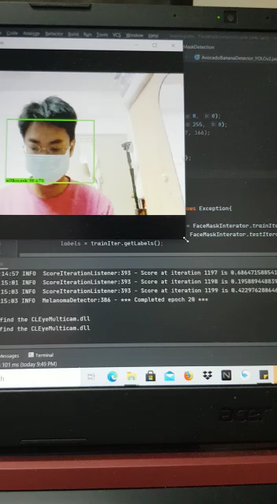

Slide 15
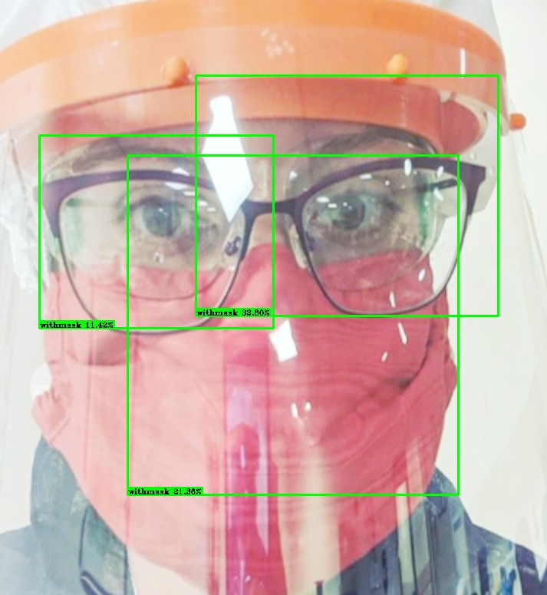
Difficulties
Odd location of resulting bounding box
Limited detection distance and angle
Detection of non-mask features
Wrong classification
Notes:
Odd location: Boxes can be off centre of person’s face
Limited distance and angle: Detection in video footage limited to 2 metres max. Angle: Almost entirely in front
Non-mask detection: Example image
wrong classification: Noise gets in the way. Happens even with good performance in testing

Slide 16
The journey: Evaluation
Post-build evaluation using test data. Makes up 10% of entire dataset.
Tested performance on video recorded in local shopping mall
Notes:
Video shows model examining nevus
Issues: No detect, detect wrong,

Slide 17
Possible improvements
More data for each output class (masked, no_mask)
Larger diversity in subjects, especially on target groups of people (eliminate model bias)
Notes:
More data: More is always better. Allow model to learn more relevant features, possible variations
Large diversity: Ensures correct detection. Avoid discrimination on race, skin colour, gender

Slide 18
Thank you!

